Slide 1







Application Security and Vulnerability Testing Week 9: By Oracle

Slide 2

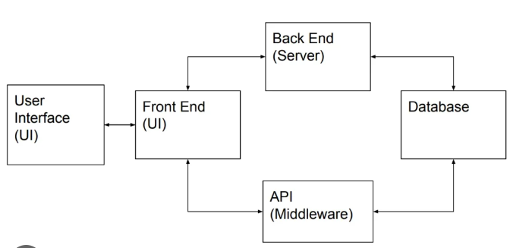



How do applications work?
Applications are collections of code that allow users to perform specific tasks, interact with data, and connect with other systems.

Slide 3
Components
Frontend (Client-side): The interface users interact with.
Backend (Server-side): Processes requests, manages data, and communicates with databases.
Database: Stores and manages application data.

Slide 4
Communication
The frontend and backend typically communicate over the internet using HTTP/HTTPS protocols.

Slide 5
Application Communication Layers
Frontend-Backend Communication:
HTTP/HTTPS Requests: Methods like GET, POST, PUT, DELETE.
RESTful APIs: Standard protocol for data exchange.
GraphQL: An alternative query language for more flexible data requests.

Slide 6
Application Communication Layers
Backend-Database Communication:
SQL Queries: Standardized query language for relational databases.
NoSQL Queries: Document, key-value, or graph-based queries for NoSQL databases.

Slide 7
Application Communication Layers
Security Concerns:
Insecure APIs: Avoid exposing unnecessary endpoints.
Data Leakage: Ensure data sent over the network is encrypted.

Slide 8



01
Introduction to Application Security

Slide 9
What is application security?
Application security is the process of developing, adding, and testing security features within applications to prevent security vulnerabilities against threats such as unauthorized access and modification.
Application security ensures applications resist attacks to protect sensitive data and maintain reliability.

Slide 10
Examples of Key Threats
SQL Injection: SQL Injection vulnerabilities occur when user inputs are directly included in SQL queries without proper sanitization or use of parameterized queries
Cross-Site Scripting (XSS): XSS vulnerabilities arise when an application accepts user input and outputs it in the browser without adequate escaping or sanitization, allowing attackers to inject malicious scripts that run in users' browsers.

Slide 11
Examples of Key Threats
Cross-Site Request Forgery (CSRF): CSRF occurs when an attacker tricks a user into unknowingly submitting a request (e.g., form submission, API call) that executes actions on their behalf without proper authorization, often by exploiting session cookies.
What are the typical targets of each of these vulnerabilities?

Slide 12
02
Application Security Testing

Slide 13
Application security features
Different types of application security features include authentication, authorization, encryption, logging, and application security testing. Developers can also code applications to reduce security vulnerabilities.

Slide 14
Authentication
When software developers build procedures into an application to ensure that only authorized users gain access to it. Authentication procedures ensure that a user is who they say they are. This can be accomplished by requiring the user to provide a user name and password when logging in to an application

Slide 15
Authorization
After a user has been authenticated, the user may be authorized to access and use the application

Slide 16
Encryption
After a user has been authenticated and is using the application, other security measures can protect sensitive data from being seen or even used by a cybercriminal.

Slide 17
Logging
If there is a security breach in an application, logging can help identify who got access to the data and how. Application log files provide a time-stamped record of which aspects of the application were accessed and by whom.

Slide 18
Application security testing
A necessary process to ensure that all of these security controls work properly

Slide 19
What is application security testing?
Application testing refers to testing any software application using scripts, tools, or test automation frameworks to identify errors. It helps teams release bug-free and robust software applications into the real world.

Slide 20
03
Methodologies for Application testing. <What is a methodology? />

Slide 21
What is OWASP?
OWASP (Open Web Application Security Project) provides a comprehensive set of resources and methodologies designed to improve software security.
Integrating OWASP practices into a DevSecOps approach helps ensure security is built into the software development lifecycle

Slide 22
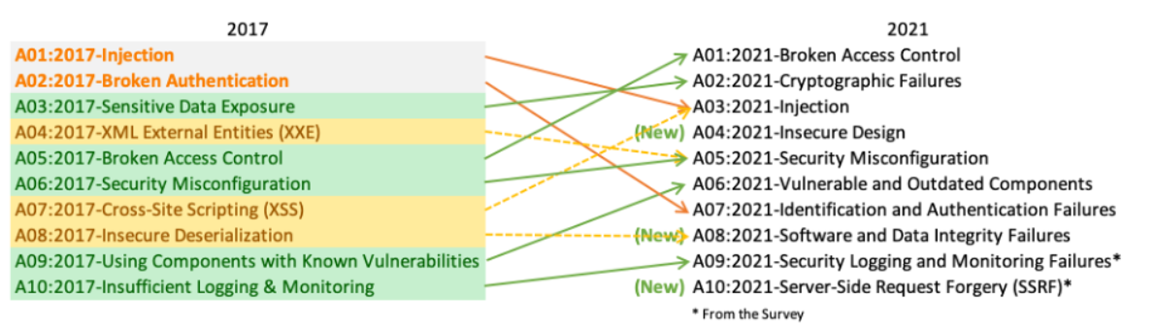
OWASP Top 10
Can you explain any two vulnerabilities in this list?

Slide 23
04
Application Security Testing Phases

Slide 24
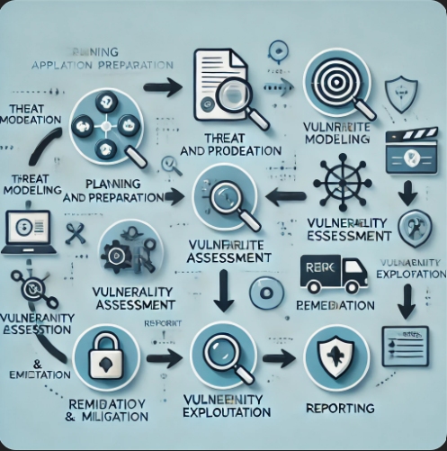
Phases/Steps
Planning and Preparation: Define objectives and create a test plan.
Threat Modeling: Identifying threats based on the app’s architecture.
Vulnerability Assessment: Automated tools to detect vulnerabilities.
Vulnerability Exploitation: Testing real-world exploitability.
Remediation and Mitigation: Fix vulnerabilities.
Reporting: Clear, actionable reports for security teams.

Slide 25
05
Burp suite

Slide 26
What is Burp suite
Burp Suite is a comprehensive platform for performing security testing of web applications. It is widely used by penetration testers and security researchers for its robust features and flexibility.

Slide 27
Key features of Burp suite
Proxy: Intercept and modify traffic between your browser and the target application.
Scanner: Automate the process of scanning for vulnerabilities.
Intruder: Automate customized brute force attacks to test for vulnerabilities.
Repeater: Manually modify and resend HTTP requests to test for vulnerabilities.
Sequencer: Analyze the randomness of session tokens.
Decoder: Transform encoded data to reveal hidden information.
Comparer: Identify differences between two sets of data.

Slide 28
Key features of Burp suite
Define Scope: Ensure only the test target is defined in Burp.
Proxy Use: Capture and inspect HTTP requests/responses.
Scanner: Automated scans to detect vulnerabilities.
Repeater: Manually edit and resend requests to simulate attacks.
Intruder: Automated input for testing fuzzing or injection vulnerabilities

Slide 29
06
Practical Exercise

Slide 30
Xx%
API Testing

Slide 31
What is an API?
API stands for Application Programming Interface. It's a set of rules and protocols that allows software applications to communicate with each other, exchange data, and share features and functionality

Slide 32
What is API testing?
API testing is a type of software testing that evaluates application programming interfaces (APIs) to ensure they meet expectations for reliability, functionality, performance, and security.

Slide 33
Importance of API testing
Identifying API Security Vulnerabilities:
Common threats: SQL Injection, XSS, etc. API breaches can lead to significant data loss.

Slide 34
API testing
To start API testing, you first need to discover its attack surface by obtaining as much information about the API as possible.
To begin, you should identify API endpoints (the locations where an API receives requests about a specific resource on its server)

Slide 35
API testing
Once you have identified the endpoints, you need to determine how to interact with them. This enables you to construct valid HTTP requests to test the API. You should find out:
The input data the API processes, including both compulsory and optional parameters.
The types of requests the API accepts, including supported HTTP methods and media formats.
Rate limits and authentication mechanisms.

Slide 36


Scenerio
In this Lab, you will practice basic interception of communication using burp suite.
At the end, you will find the exposed API documentation and delete the user Carlos from the database of the eCommerce site to highlight

Slide 37
Write a report on the incident, highlighting the process, intrusion techniques applied, the scope of the test and while suggesting fixes to prevent this vulnerability from being exploited.
Assignment

Slide 38
Thanks!
Do you have any questions?
amosmarvellous48@gmail.com
+234 702 625 4613

